Slide 1
Automatic Retina Disorder Detection using OCT images
Group member Details:
Ajay Kushwaha (16104013)
Neelu Gupta (16103243)
Somil Rastogi (16103193)

Slide 2
What is OCT?
Optical Coherence Tomography is a technique developed for non-invasive imaging of biological cells extensively used by Ophthalmologists to study the structure of the retina and related diseases. OCT is analogous to ultrasound where it uses low-coherence interferometry to produce a two-dimensional image of optical scattering. It has longitudinal and latitude spatial resolution which is capable of detecting very small reflected signals from retina approximately 10(-10) of the incident optical power.

Slide 3
Problem Statement
With millions of people across India reporting CNV, DME and Drusen annually, it has become very crucial to detect these disorders on time to start their treatment as some of these can not be cured after a point of time.Currently, trained ophthalmologists clinically examine the presence of any retinal disease like DME, CNV and Drusen. To enable remote identification of diseases and speed up the diagnostic process, automated analysis of OCT images has remained an active field of research since the early days of OCT imaging.We have developed a new intelligent system based on deep learning to automatically categorize OCT images to aid clinicians and make the process faster and more accurate. The framework has the capability to increment diagnostic efficiency, enable easier access to expert knowledge, facilitate remedial decision-making, and decrease overall healthcare costs.

Slide 4
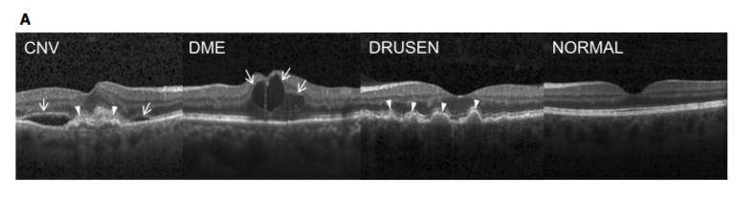
4 Classes

Slide 5
Significance/Novelty Of the Problem
To speed up the diagnostic process and enable remote identification of diseases, automated analysis of OCT images has remained an active field of research since the early days of OCT imaging. The problem that our automated system is solving will be going to help a lot of clinicians to efficiently detect these abnormalities and help the patients as it is very cost effective and reliable.
Until now, all the studies that have aimed to diagnose these retinal diseases, have made use of huge, complicated CNN models like ResNet, VGG16, InceptionV3 etc and have focused on binary classification or staging of diseases. Our work is a multi classification problem that makes use of only basic 3 Layer, 5 Layer and 7 Layer model and has achieved competing accuracies by only tuning the hyperparameters.

Slide 6
CNN and CNN Layers
Convolution Layer
Relu layer
Max Pooling Layer
Flattening Layer
Dense (ANN) Layer

Slide 7
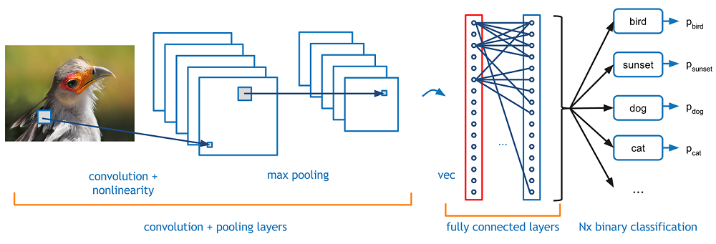
CNN WorkFlow

Slide 8
Information about the Dataset
Link to the dataset - https://www.kaggle.com/paultimothymooney/kermany2018
The data was collected from Kaggle.com which was uploaded by Paul Mooney and is licensed by Non Commerical ShareLike 4.0 which gives the permission to Share and Adapt. We have used this particular data set in our project, whose summary is as follows:
Total Images: 84495
Final Evaluation: 968 Images
242 Images per category in the final evaluation
There are 84,495 OCT images (JPEG) and 4 categories (NORMAL,CNV,DME,DRUSEN).

Slide 9
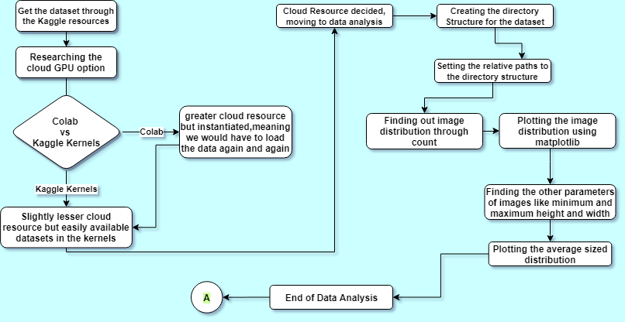
Data Analysis Flowchart

Slide 10
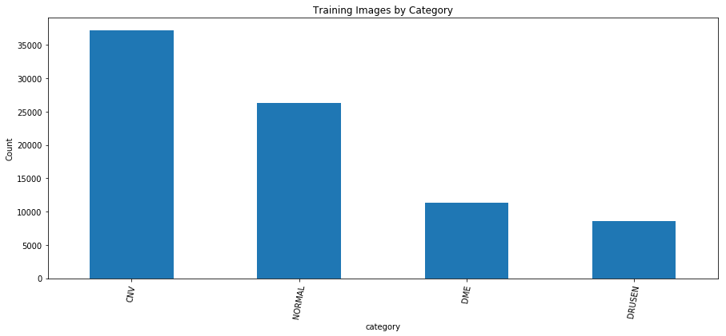
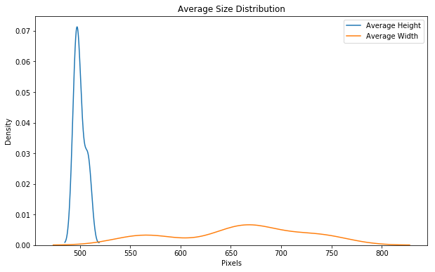
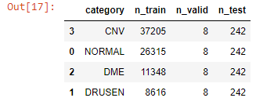
Data Analysis Results

Slide 11
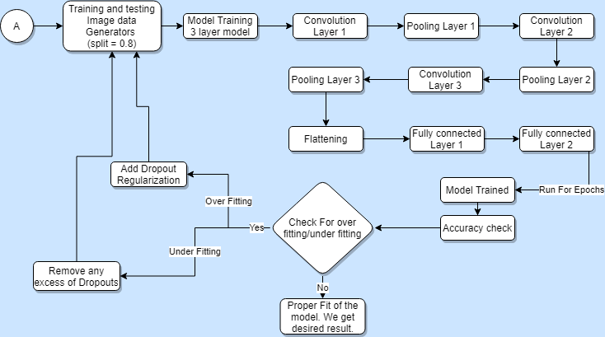
Baseline 3 Layered Model (95.833%)

Slide 12
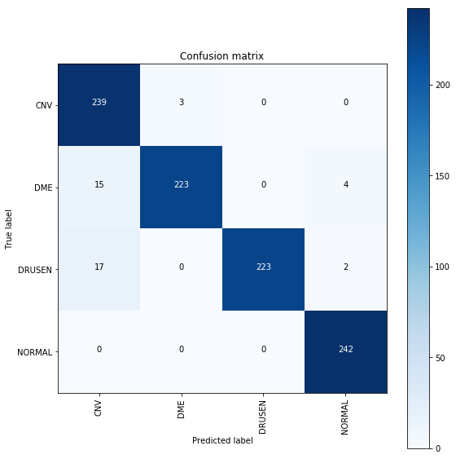
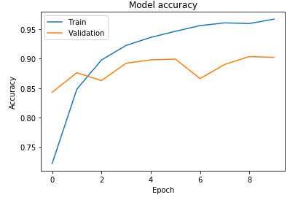
Baseline Model Results

Slide 13
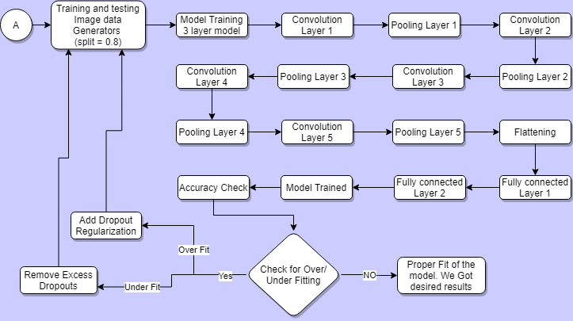
5 Layered Model (256X256 = 97.5% ; 64X64 =97.91%)

Slide 14
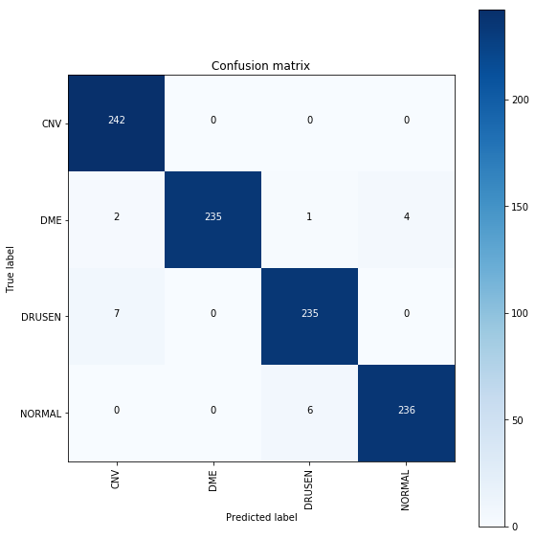
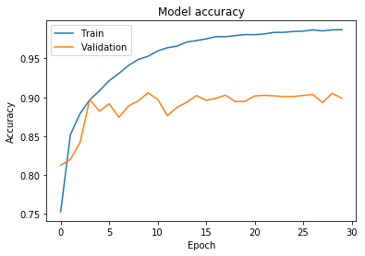
5 Layer Model Results

Slide 15
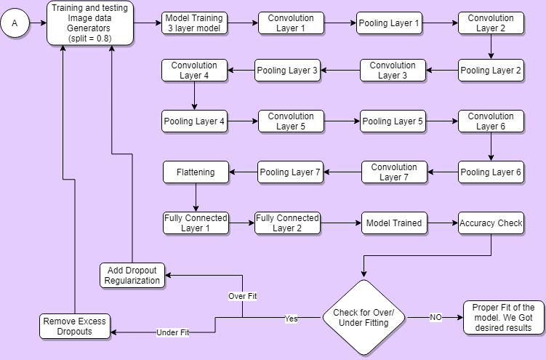
7 Layered Model(256X256 = 94.791% ; 64X64 = 96.458%)

Slide 16
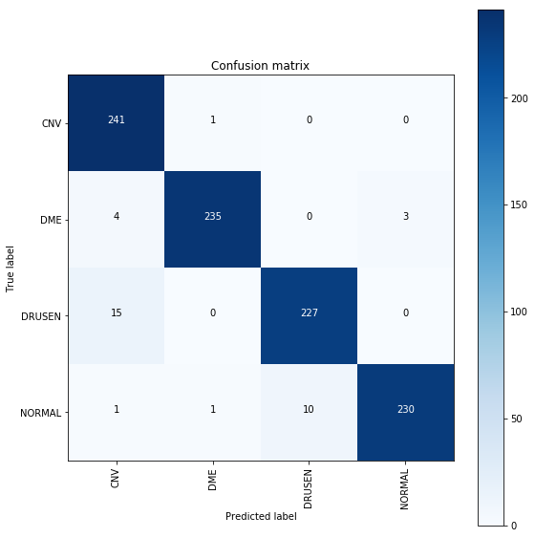
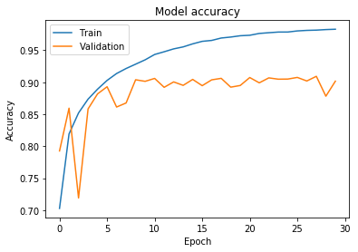
7 Layer Results

Slide 17
Model Specification | Image Size | Epochs | Model Loss(Testing) | Model Accuracy(Testing)
Baseline model(3 layers) | 256X256 | 10 | 0.03542 | 0.95833
5 layer model | 256X256 | 10 | 0.03535 | 0.97500
5 layer model | 64X64 | 30 | 0.00173 | 0.97916
7 layer model | 256X256 | 10 | 0.02414 | 0.94791
7 layer model | 64X64 | 30 | 0.12601 | 0.96458

Slide 18
Major Challenges Faced
Finding of a Cloud GPU resource so as to perform our training and testing part.
Hyper parameter optimization like optimizing the image size and number of epochs.
Dealing with overfitting by using dropout regularization.
Finding out the exact number of dropouts required so that model does not go into underfit and actually fits correctly.
Being extremely patient while model training and testing as even with the GPU resource, the training process would take hours.

Slide 19
We would like to express our sincere gratitude to our evaluation committee for providing a just and fair evaluation to our efforts and understanding the core of our ideologies kept in mind while working for this project. We would especially like to thank our supervisor – Mr. Pawan Kumar Upadhyay for providing his invaluable guidance, comments and suggestions throughout the course of the project.
Thank You.

